Slide 1
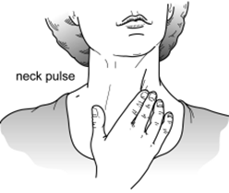
Dear Arlington Families:
In order to meet the required 60 minutes of physical activity per day, Arlington P.E. teachers have developed this fitness calendar for your child’s use at home. In addition to the activities listed for each day, students are encouraged to walk or jog for a total of 30 minutes per day. We recognize everyone will not have access to all of the equipment listed. Do your best!
Thank you.
Healthy Eating
Students are encouraged to eat a fruit or vegetable with every meal. Students should also be mindful about eating healthy snacks throughout the day.
Additional Activities & Resources
Here is a list of additional activities that can be incorporated throughout the day:
Bounce a ball 50 times with each hand.
Visit your local playground with parent supervision.
Play catch with a family member.
Dribble a ball soccer-style outdoors.
Perform 20 wall push ups.
Toe tap a soccer ball or similar ball 50 times.
GoNoodle.com
Just Dance for Kids (on YouTube Kids)
SworkIt Kids (app with kid friendly exercises)
Cosmic Kids (app with kid friendly yoga activities)
Play60.com
Heart Rate Check:
Students are encouraged to check their resting heart rate and then their working heart rate after these activities. Feel your pulse for 6 seconds with your index and middle finger on your wrist or your neck. Count the beats. Multiply by 10. That is your heart rate.

Slide 2
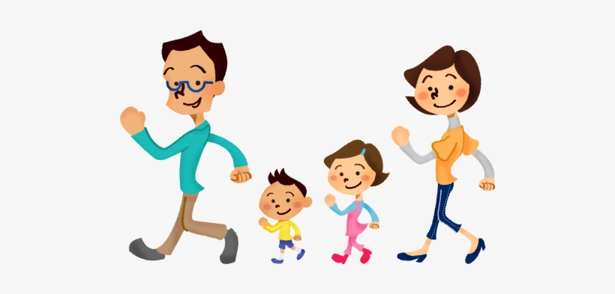
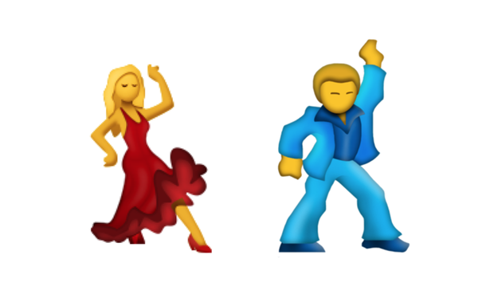
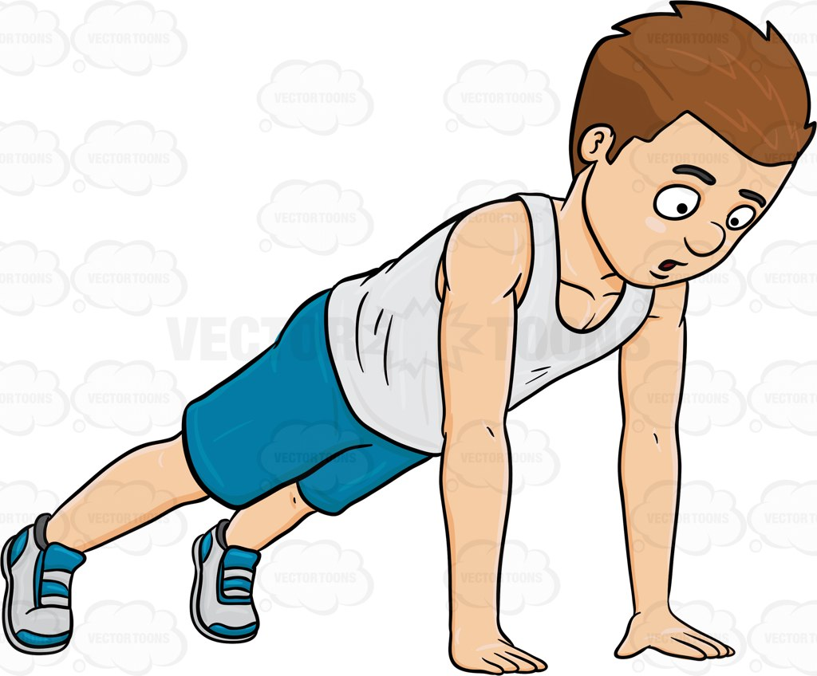
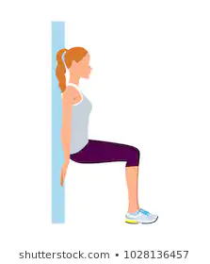
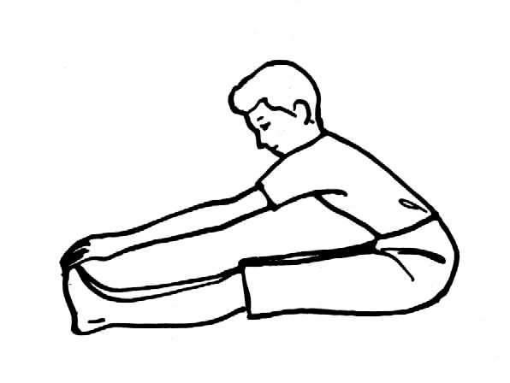
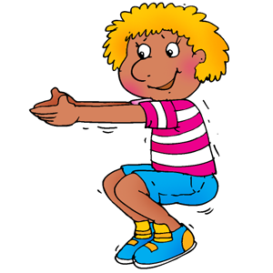
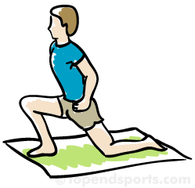
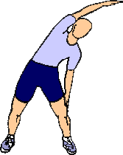
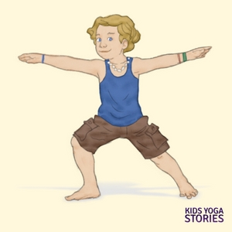
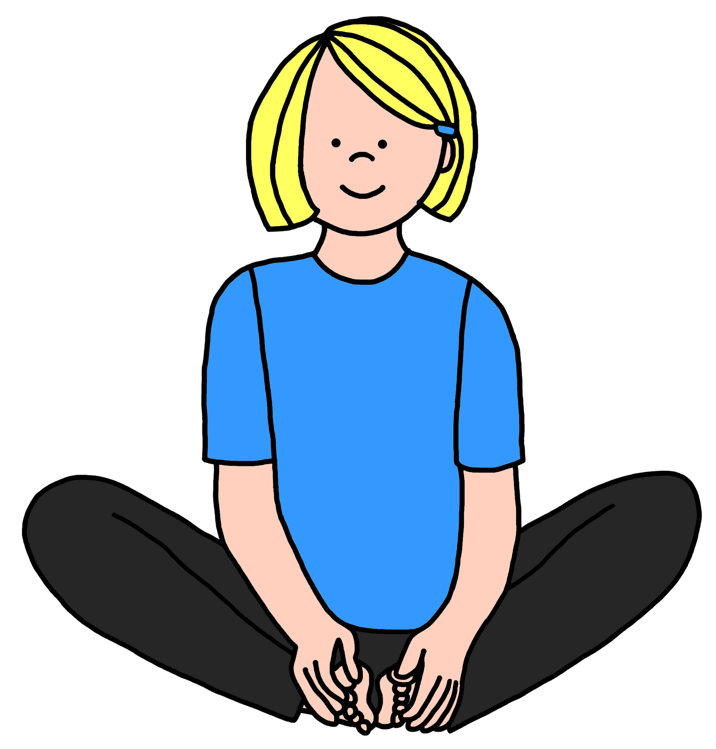
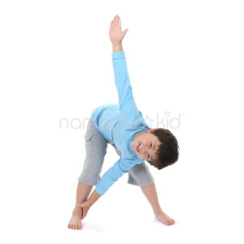
Cardio: Ride your bike for 20 minutes Muscular Strength How many push-ups can you do? Flexibility: Hold the downward dog for as long as you can | Cardio: Walk for 30 minutes Muscular Strength: Do 25 sit-ups Flexibility: In a sitting position reach out and touch your toes for 15 seconds | Cardio: 25 jumping jacks + 25 Star Jumps Muscular Strength: Hold a plank for 1 minute Flexibility: Lie down on back and spread arms and feet in a snow angel motion for 1 minute | Cardio: Indoor Dance Party! Dance to your favorite songs for 20 minutes Muscular Strength: Wall-Sit for 30 seconds Flexibility: In the superman pose, lift a book off the ground and read one entire page | Cardio: Find some stairs- go up fast and down slowly! Do this for 5 minutes- check your pulse after too! Muscular Strength: Try a side plank- 30 seconds on the right and 30 seconds on the left Flexibility:Do 25 slow arm circles forward and 25 slow arm circles backward
Cardio: Jog for 30 seconds in each room of your home Muscular Strength: Do 25 front lunges on each leg Flexibility: Hold the warrior pose for as long as you can | Cardio: Star Jump- Drop to a squat position and then explode up into the air into a star position 20 times Muscular Strength: Do 20 wall-push-ups Flexibility: Butterfly stretch for 20 seconds- take a break- repeat 3 times | Cardio: Jump Rope (or invisible jump rope) for 5 minutes’ total Muscular Strength: Hold a push-up position and say the months of the year 3 times Flexibility: Standing Side Stretch- arms over your head and bend to one side- try 30 seconds on each side | Cardio: Jump side to side (ski jump) over a line on the floor for 2 minutes Muscular Strength: 25 Squats- imagine that you are sitting on a chair Flexibility: Wall Calf Stretch- 2 hands on the wall, one knee bent, back leg straight | Cardio: Repeat your favorite cardio! Challenge yourself! Muscular Strength: Do bicycle legs with a family member for 60 seconds Flexibility: Bending Wind Mills- start in a standing star position- opposite hand reaches to opposite foot

